Slide 1
Sports Predictor 3000
Harrison Waldon, Connor VanDrunen, Riccardo Maffei, Piotr Salustowicz

Slide 2

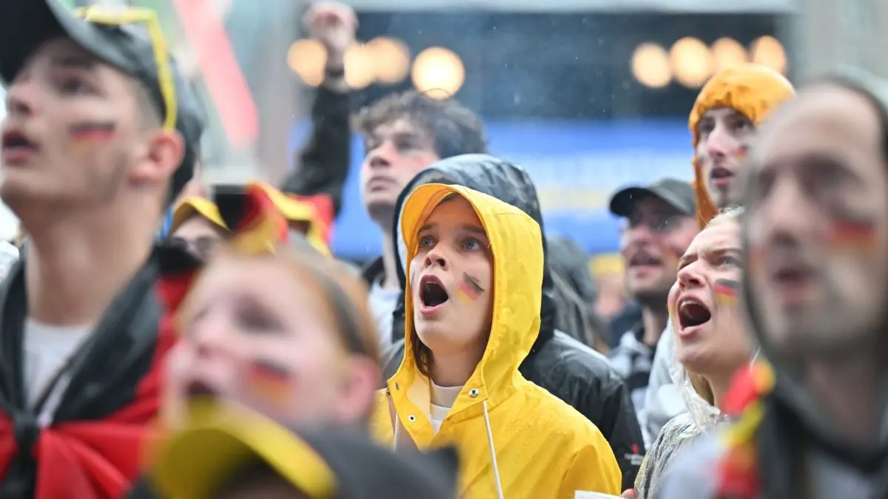




Slide 3
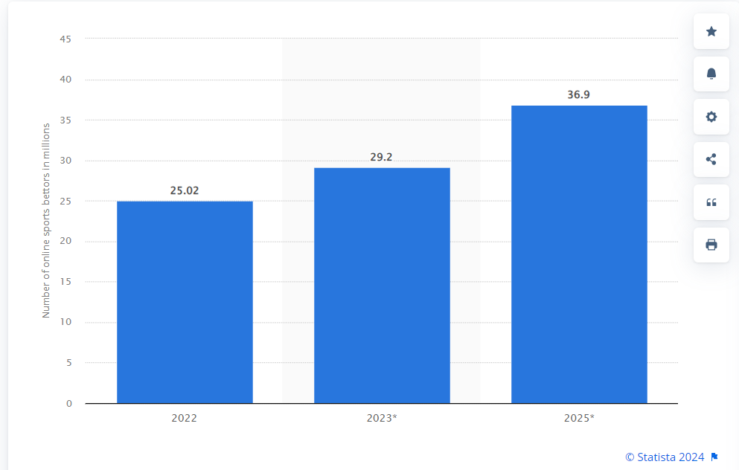
Sports Betting Is Very Popular
Sports betting is one of the fastest growing and most popular forms of betting in the world.
In the Online Sports Betting market, the number of sports bettors in Europe is expected to amount to 36.9m users by 2025.

Slide 4
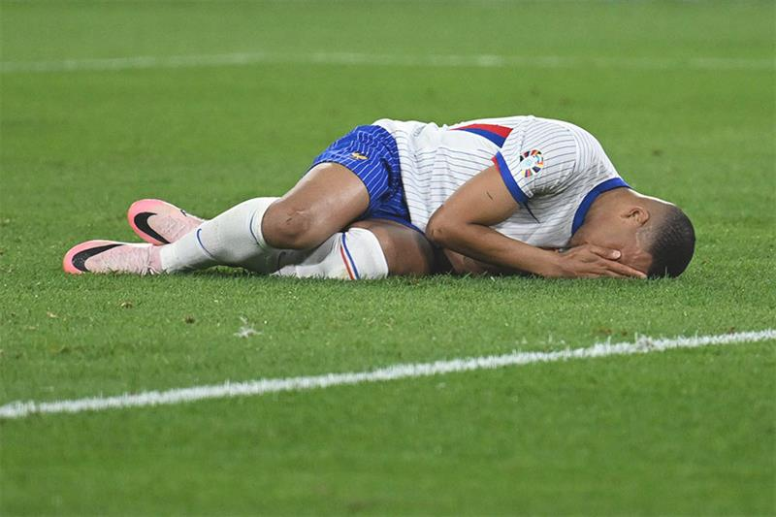
The Problem
Even with logical human predictions, it is nearly impossible to consistently predict matches accurately.
Despite the popularity of sports betting, only about 3% of sports bettors are profitable.
How can we make sports betting more profitable for the average user?

Slide 5

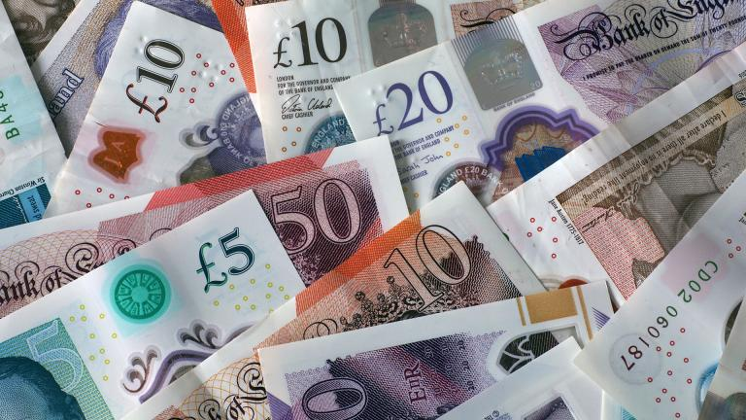
The Solution?
A prediction model with a user-friendly interface, allowing you to identify the winner of a match
Goal: Increase the chance of winning sports bets

Slide 6
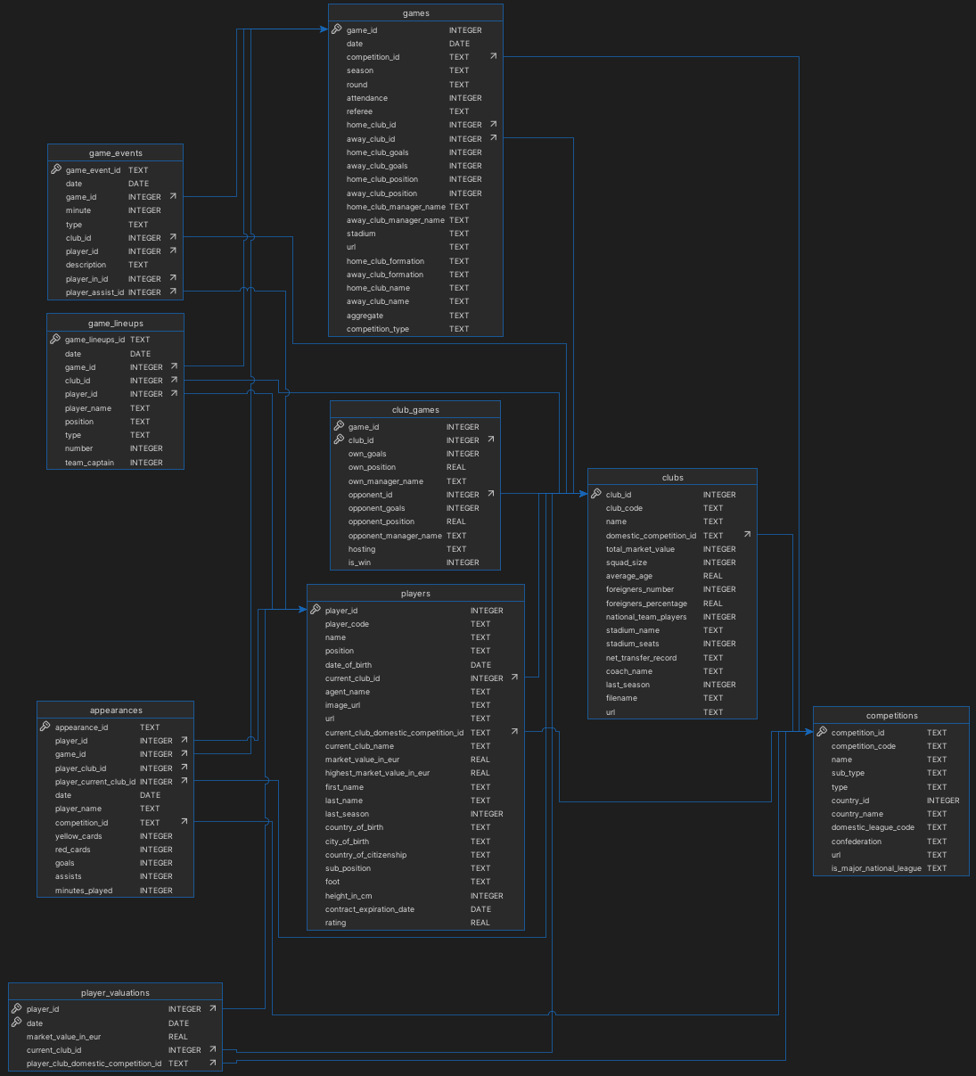
The Methods
Collected data on player information and statistics
Data is scraped weekly from Transfermarkt.com
Developed a database with our collected data
This way, we can better access and use the data
Data Processing
Created a neural network that can train and test a data model

Slide 7
The Prototype

Slide 8
Evaluation
We evaluated several different data models. The best model we had:
The overall accuracy was around 46%
The accuracy of predicting a home team win was 59%
The accuracy of prediction a home team loss was 38%
The draw rate was 33%

Slide 9
Problems That We Encountered
We first gathered a lot of datasets, but a lot of them were imprecise
We scraped the UEFA website for historical games, but a lot of the data was unreliable
Some of the data was incomplete

Slide 10
How Can We Improve Our Product?
Scrape more data from different websites
Gather more precise data
Continue training and improving the model
Try out new models with different combinations of data
Finalize the user interface

Slide 11
Conclusion
Goal: Create a user-friendly soccer game predictor
Achievement status: Overall model accuracy of 46%
Future potential

Slide 12


